Slide 1
Driver Alertness Detection
PIP2001 Capstone Project
Review-1
Batch Number:168
Under the Supervision of,
Mr.Afroj Alam
Professor / Associate Professor / Assistant Professor
School of Computer Science and Engineering
Presidency University
Roll Number | Student Name
20221LCS0012 | Parachuru Padma Sanjana
20221LCS0006 | Yakesh Krishnan.D
20221LCS0019 | Ashok K
20211CSE0482 | L.Jayakrishna
Name of the Program: CSE
Name of the HoD: Dr.Asif Mohammed H.B
Name of the Program Project Coordinator: Mr. Amarnath J.L & Dr. Jayanthi. K.
Name of the School Project Coordinators: Dr. Sampath A K / Dr. Abdul Khadar A / Mr. Md Ziaur Rahman

Slide 2
Introduction
Driver Alertness: A Major Concern Drowsy driving is a serious issue in transportation and a major cause of accidents worldwide. In India, around 1,37,000 people lost their lives in road accidents in 2013, which means one death every four minutes. Fatigue and distraction are big contributors, with 37% of drivers admitting to falling asleep behind the wheel and 60% saying they've driven while drowsy. These numbers show the urgent need for better systems to keep drivers alert and prevent accidents.
Project Goal This project aims to create a compact system for cars and trucks that detects driver drowsiness and distraction using image processing. The system continuously monitors the driver’s eyes and head movements to spot signs of fatigue, like slow blinking or head turning. If a problem is detected, the driver is quickly alerted through an alarm or vibrations.
How It Works A dashboard-mounted camera captures video, which is processed using an on-board processor or cloud services. The goal is to make this system a standard safety feature in vehicles, similar to airbags, to help prevent accidents and save lives.

Slide 3
Literature Review
Research in the field of driver alertness detection has gained momentum over the past decade due to the increasing number of road accidents linked to driver fatigue and distraction. Various studies have explored different methods for monitoring driver behavior, primarily focusing on physiological measures, vehicle-based measures, and behavioral measures.
Physiological Measures Several methods rely on physiological indicators such as heart rate, brain activity (EEG), and skin conductance to detect drowsiness. Studies have shown that changes in heart rate variability and increased EEG theta activity correlate with driver fatigue. However, these methods often require intrusive equipment like electrodes, which can be impractical for real-time applications in vehicles. The high cost and complexity of implementing physiological monitoring limit its widespread adoption.
Vehicle-Based Measures Another approach involves monitoring vehicle behavior, such as lane deviation, steering wheel movements, and speed variations, to infer driver drowsiness. This method has been used in some commercial driver assistance systems to issue alerts when irregularities in driving patterns are detected. However, vehicle-based measures may not always be reliable, as external factors such as road conditions, vehicle type, and driving style can significantly influence the accuracy of the system.
Hybrid Approaches Combining multiple detection methods can enhance system accuracy and robustness. For example, integrating eye-tracking with vehicle-based measures can reduce false positives and improve detection rates. Research has also explored the use of machine learning techniques to analyze combined data sources, allowing the system to adapt to individual driving patterns.

Slide 4
Existing method Drawback
Physiological Measures (e.g., Heart Rate, EEG, Skin Conductance)
Intrusiveness: These methods often require the use of sensors attached to the body, such as heart rate monitors, EEG electrodes, or skin conductance sensors. This can be uncomfortable for drivers and may not be suitable for long-duration use.
High Cost and Complexity: Implementing physiological monitoring in vehicles is costly due to the need for specialized equipment and sensors. Maintenance and calibration also add to the expenses, making it impractical for widespread use.
Response Time Lag: Physiological changes can be slow to manifest, meaning that there may be a delay in detecting fatigue or distraction. This lag reduces the system's effectiveness in providing timely alerts to prevent accidents.
Sensitivity to Environmental Factors: Changes in temperature, humidity, or vehicle vibrations can affect the accuracy of physiological sensors, leading to false positives or missed detections.

Slide 5
Proposed Method
Real-Time Image Processing for Eye-Tracking and Blink Detection
The system continuously monitors the driver's eyes using a dashboard-mounted camera to detect delayed blinking patterns and eye closure duration (PERCLOS - Percentage of Eyelid Closure). Prolonged eye closure or frequent blinking can be strong indicators of drowsiness.
Advanced image processing algorithms, such as facial landmark detection and optical flow techniques, are employed to track eye movement and detect changes in blink frequency, sluggishness, or partial eye closure.
The system operates in various lighting conditions by incorporating infrared (IR) technology to maintain detection accuracy during nighttime driving or poor visibility.
Head Pose Estimation for Distraction Detection
The system monitors the driver's head orientation to detect deviations from a safe range of angles. If the driver's head turns beyond a predefined threshold (e.g., more than 100 degrees) and remains turned for over two seconds, the system triggers an alert.
Using 3D head pose estimation techniques, the system calculates the driver's head rotation and tilt, accounting for safe limits for monitoring the road.
This feature also helps detect conversations with passengers, as extended head turning towards other occupants may indicate distraction.

Slide 6
Objectives
Detect Driver Drowsiness Early and Accurately
Implement an image processing-based system that continuously monitors the driver's eyes to detect early signs of drowsiness, such as prolonged eye closure, delayed blinking, and sluggish eye movements.
Use real-time analysis of blinking patterns and eye closure metrics (e.g., PERCLOS) to generate timely alerts, reducing the risk of accidents caused by fatigue.
Monitor and Alert for Driver Distraction
Develop a head pose estimation mechanism to detect unsafe head movements, such as turning away from the road or extended conversations with passengers.
Set thresholds for head rotation angles and time limits (e.g., head turning more than 100 degrees for over 2 seconds) to identify potentially hazardous distractions and notify the driver accordingly.
Provide Real-Time, Multi-Modal Alerts
Ensure that the system delivers immediate alerts through auditory alarms, vibrating mechanisms (e.g., seat or steering wheel), or visual signals to capture the driver's attention when drowsiness or distraction is detected.
Customize alert types and intensities based on the severity of detected issues to prevent accidents effectively.

Slide 7
Methodology/Modules
Methodology-
Data Acquisition
A camera is installed on the dashboard, facing the driver, to capture continuous video footage of the driver’s face. The camera is equipped with infrared (IR) capabilities to ensure reliable operation under different lighting conditions, such as nighttime or bright sunlight.
Preprocessing
The captured video frames undergo preprocessing, which includes noise reduction, grayscale conversion, and normalization. This step ensures that the images are in a suitable format for further analysis and enhances the robustness of the system across different environments.
Modules-
Data Acquisition Module
Function: Captures real-time video footage of the driver's face using a dashboard-mounted camera.
Components: Camera (with IR capabilities), video capture software.
Preprocessing Module
Function: Prepares the captured video frames for analysis by reducing noise, converting images to grayscale, and normalizing the data.
Components: Image processing libraries (e.g., OpenCV), algorithms for noise reduction and grayscale conversion.

Slide 8
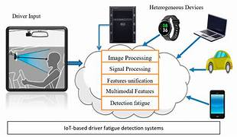
Architecture

Slide 9
Hardware/software components
Hardware Requirements:
Microprocessor:
Raspberry Pi (preferable due to GPIO support for interfacing the buzzer) or similar microcontroller like Arduino (though TensorFlow processing would need offloading to a computer).
Intel NUC or Jetson Nano for advanced AI processing on the edge.
Webcam:
Standard USB webcam (720p or above) or a Raspberry Pi Camera Module for real-time video capture.
Piezoelectric Buzzer:
A small piezo buzzer for generating audio alerts when drowsiness is detected.
Power Supply:
Power supply for the microprocessor (e.g., 5V/2A for Raspberry Pi).
Connectivity:
Internet connectivity may be required for cloud-based training or updates (Wi-Fi or Ethernet module).
Monitor and Keyboard (optional):
For initial setup and debugging of the system.

Slide 10
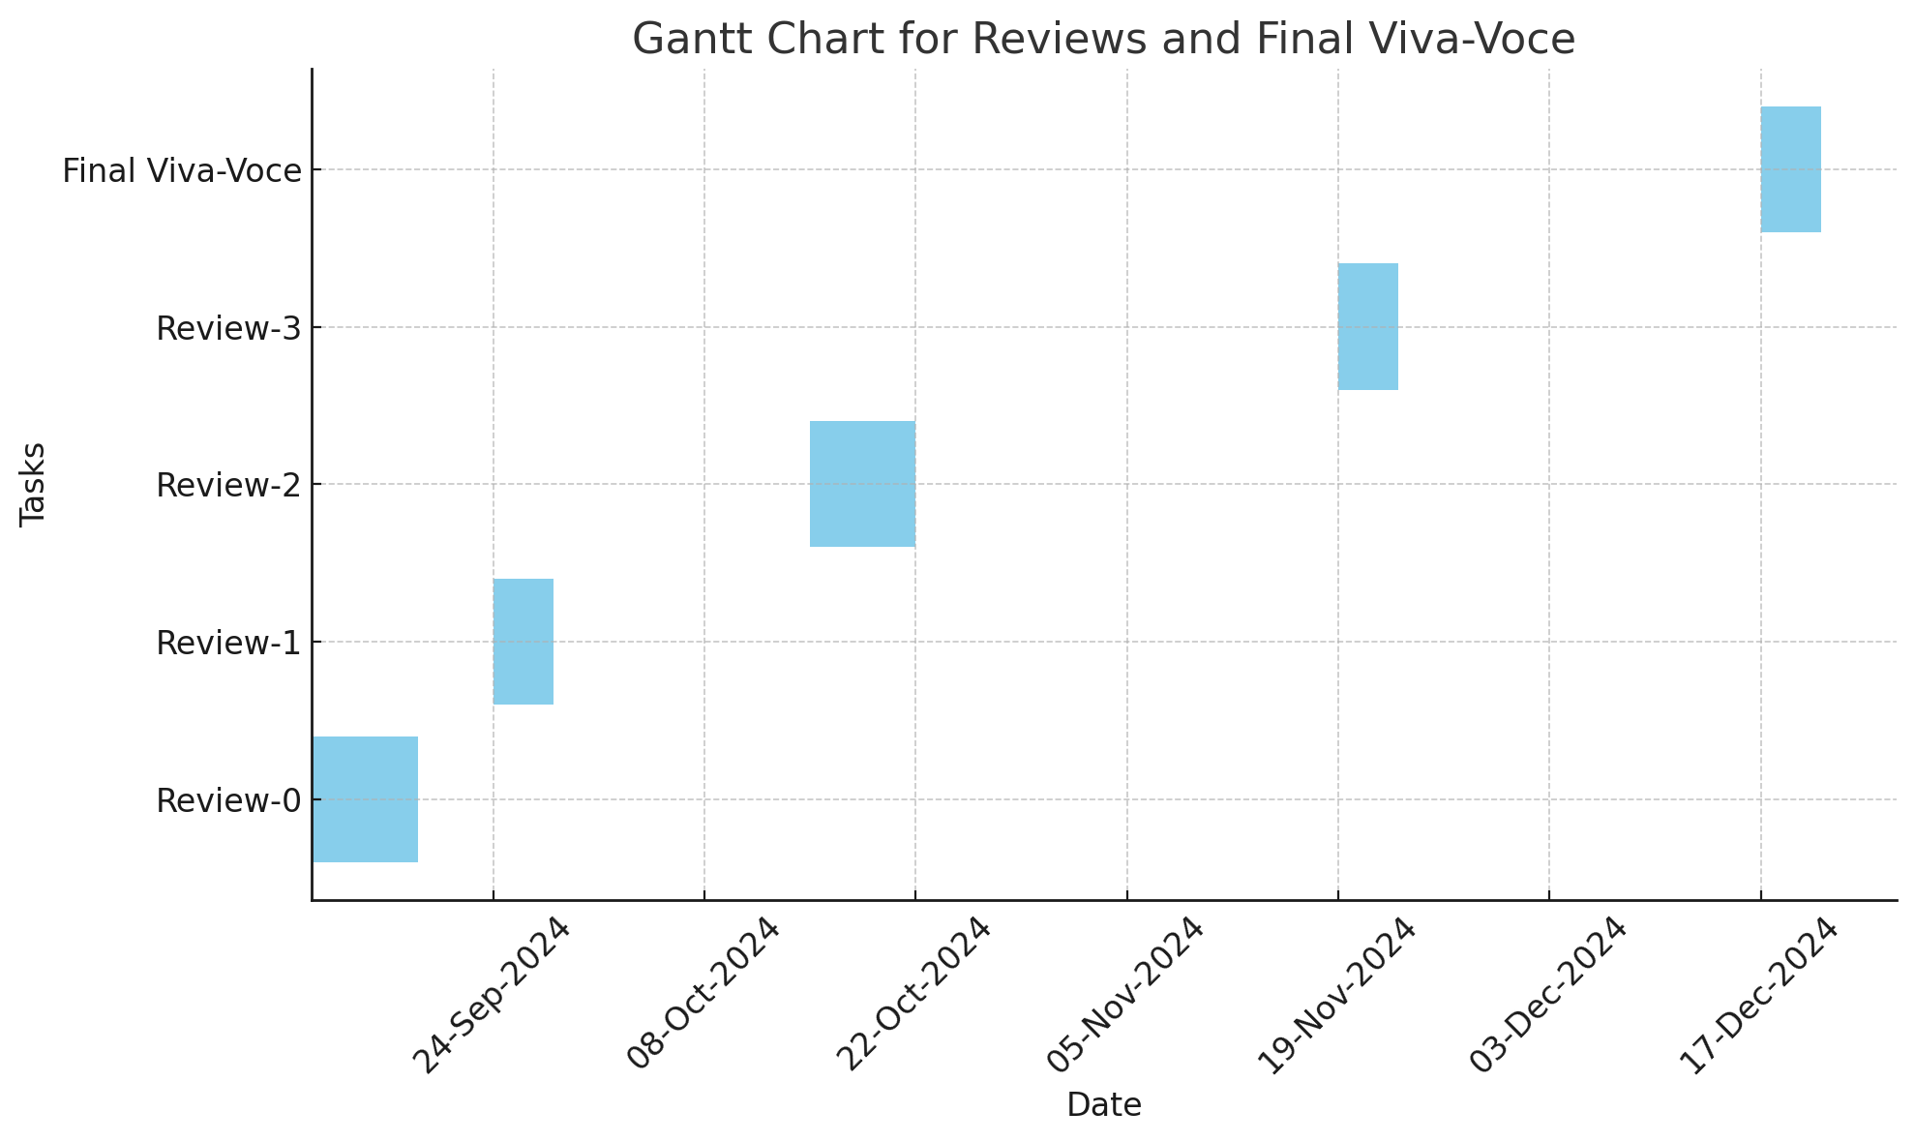
Timeline of Project

Slide 11
Expected Outcomes
Real-Time Detection of Driver Drowsiness
The system will accurately detect signs of drowsiness, such as:
Prolonged eye closure: The system should identify when the driver's eyes are closed for more than a specific duration (e.g., 1.5–2 seconds).
Frequent or delayed blinking: Abnormal blinking patterns, such as frequent blinking or longer blink duration, will be detected as signs of fatigue.
The system will provide reliable detection during various driving conditions, including daytime, nighttime, and low-light environments.
Detection of Driver Distraction
The system will monitor the driver's head movements to detect distractions such as:
Head turning away from the road: If the driver turns their head beyond a defined angle (e.g., more than 100 degrees) for more than 2 seconds, the system will identify this as a distraction.
Extended conversations with passengers: The system will detect head movements toward passengers that exceed the safe time limit and generate alerts accordingly.

Slide 12
Conclusion
Addressing Road Safety The proposed driver alertness detection system aims to reduce accidents caused by drowsiness and distraction. It uses real-time image processing, machine learning, and multiple alert methods to monitor driver behavior. By tracking eye blinks and head movements, the system can accurately detect fatigue and distractions, sending quick alerts to help prevent dangerous situations.
Smart and Adaptable System The system can adapt to individual driver habits and changing conditions, thanks to its learning capabilities. This helps improve detection accuracy and reduces false alarms. It also uses infrared technology to work well in different lighting, from bright daylight to nighttime.
Ready for Integration With its modern design and advanced hardware, the system can be easily added to new vehicles during manufacturing, just like airbags. If widely adopted, it could greatly improve road safety and save thousands of lives each year.

Slide 13
Github Link
The Github link provided should have public access permission.
Github Link
https://github.com/Parachuru1/driver-alertness-detection.git

Slide 14
References
Haar, P. (2001). Rapid Object Detection using a Boosted Cascade of Simple Features. In Proceedings of the 2001 IEEE Computer Society Conference on Computer Vision and Pattern Recognition (CVPR).
Ali, F. F., & Ashraf, I. (2020). A comprehensive review of driver drowsiness detection systems. IEEE Access, 8, 23480-23502. doi:10.1109/ACCESS.2020.2971965
Cohen, H., & Keren, N. (2015). Detection of drowsiness in drivers using facial features. Proceedings of the IEEE Intelligent Vehicles Symposium, 2015, 926-931. doi:10.1109/IVS.2015.7196048

Slide 15

Project work mapping with SDG

Slide 16


